Slide 1
Potential Energy and
Energy Conservation
Lectures by Dr Vijayakumar S
Lectures by Dr Sharafudeen K N

Slide 2
Outline
Gravitational potential energy
Conservation of mechanical energy
Conservation of energy:
(a)when gravity only does work
(b)when forces other than gravity do work
Elastic potential energy
Situations with both gravitational and elastic forces
Conservative and non-conservative forces
Conservation of energy

Slide 3
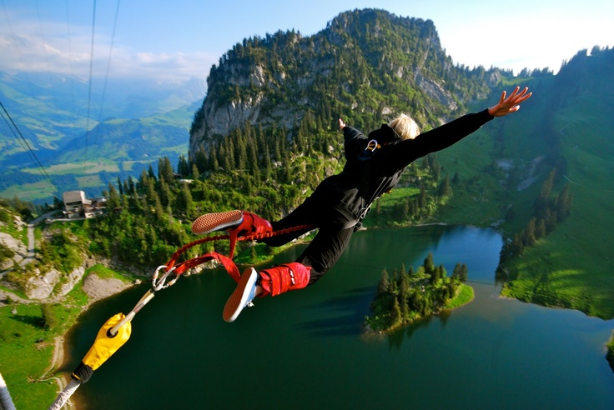
Physics of bungee jumping
How do energy concepts apply to the bungee jumper?
Yes, gravity does work and kinetic energy (KE) increases when he comes down
or we can think of energy as being
stored and transformed from one form to another
Energy associated with position of a system is called Potential Energy (PE).
PE associated with a body’s weight and height above the ground is called gravitational PE (Ugrav).

Slide 4
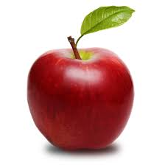
Gravitational potential energy
Work done by gravity to move the body
to the ground,
Fg = mg
Wgrav =Fs cos$∅$= mg.y.1= mgy
y
Gravitational PE associated
with a body,
Ugrav = mgy

Slide 5
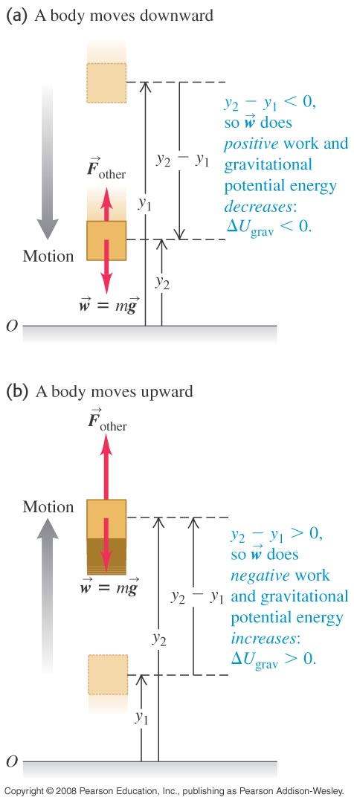
Gravitational potential energy
Work done by gravitational force to make
a displacement from y1 to y2,
$W_{grav}=mgy_{1}−mgy_{2}$= $U_{grav,1}{− U}_{grav,2}$
$${{ W}_{grav}=−∆U}_{grav}$$
Reason for the -ve sign,
when the body moves up, work done by gravity is negative
and the gravitational PE increases
when the body moves down, gravity does positive work, and
the gravitational PE decreases

Slide 6
Conservation of mechanical energy: when gravity only does work
The total mechanical energy of a system is the sum of its kinetic energy and potential energy.
A quantity that always has the same value is called a conserved quantity.
When only the force of gravity does work on a system, the total mechanical energy of that system is conserved.
$$If only gravity works on the system,$$
$$then as per the work−energy theorem,$$
$the total work done on the body is the change in KE of the body$
That is, ${−∆U}_{grav}=∆K$
$${U_{grav,1}−U_{grav,2}=K_{2}−K}_{1}$$
$$U_{grav,1}+K_{1}=U_{grav,2}+K_{2}$$
$U+K=constant$= E

Slide 7
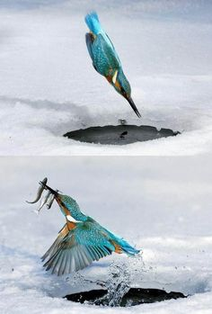
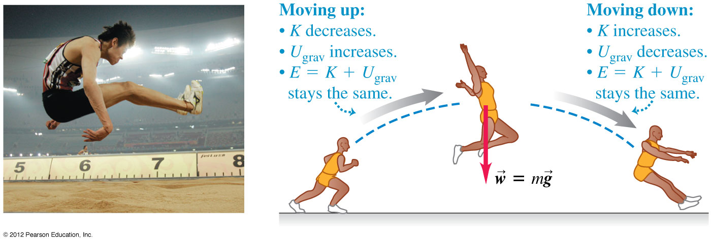
Conservation of energy:
when gravity only does work
E = U + K
ENERGY
Variation of K, U and E with
height of a body above the ground
U
K
h=0
h
HEIGHT
(ABOVE REFERENCE LEVEL)

Slide 8
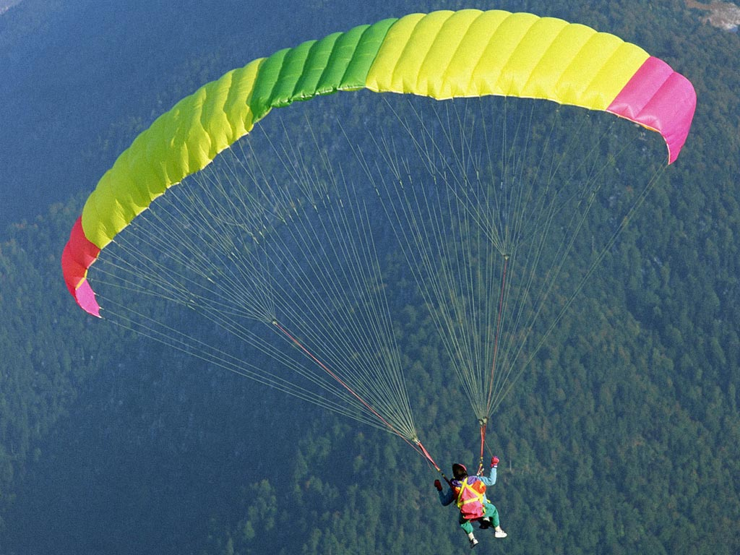
Conservation of energy:
when forces other than gravity do work
$W_{grav}$ +${ W}_{other}=K_{2}−K_{1}$
${K_{1}+U}_{grav,1}$ +${ W}_{other}=K_{2}+U_{grav,2}$
The work done by all forces other than the gravitational force equals the change in the total mechanical energy E of the system
F other
displacement
when $W_{other }$ is positive, E increases
when $W_{other }$ is negative, E decreases

Slide 9
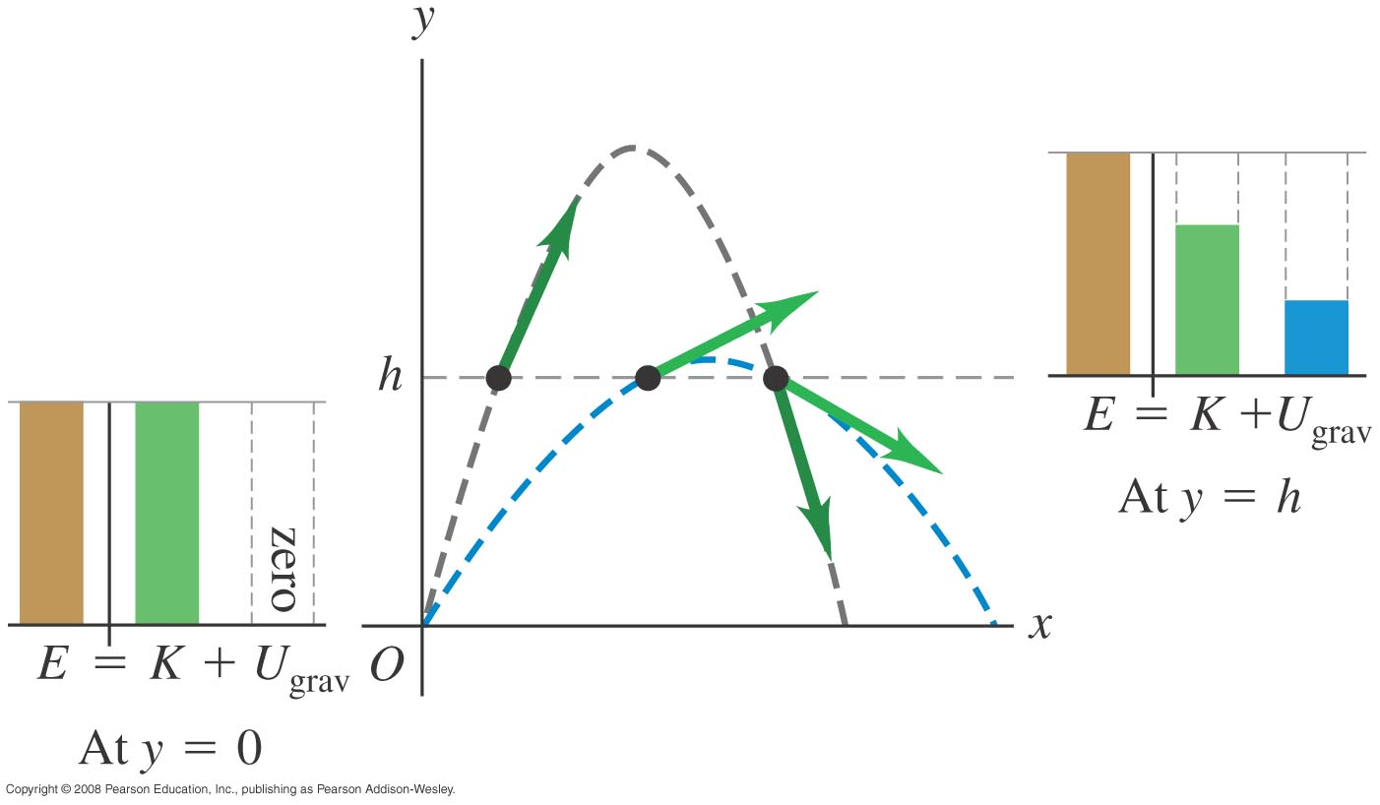
Energy in projectile motion
Two identical balls leave from the same height with the same speed but at different angles.
When the path is slanted or curved, work done
by gravity is the same as though the body had
been displaced vertically to a distance without
any horizontal displacement
Thus the speed of a projectile
at a given elevation h is always
the same, if we ignore air resistance

Slide 10
Elastic potential energy
A body is elastic if it returns to its original shape after being deformed.
Elastic potential energy is the energy stored in an elastic body, such as a spring.
The elastic potential energy stored in an ideal spring is $U_{el}=\frac{1}{2}{kx}^{2}$

Slide 11
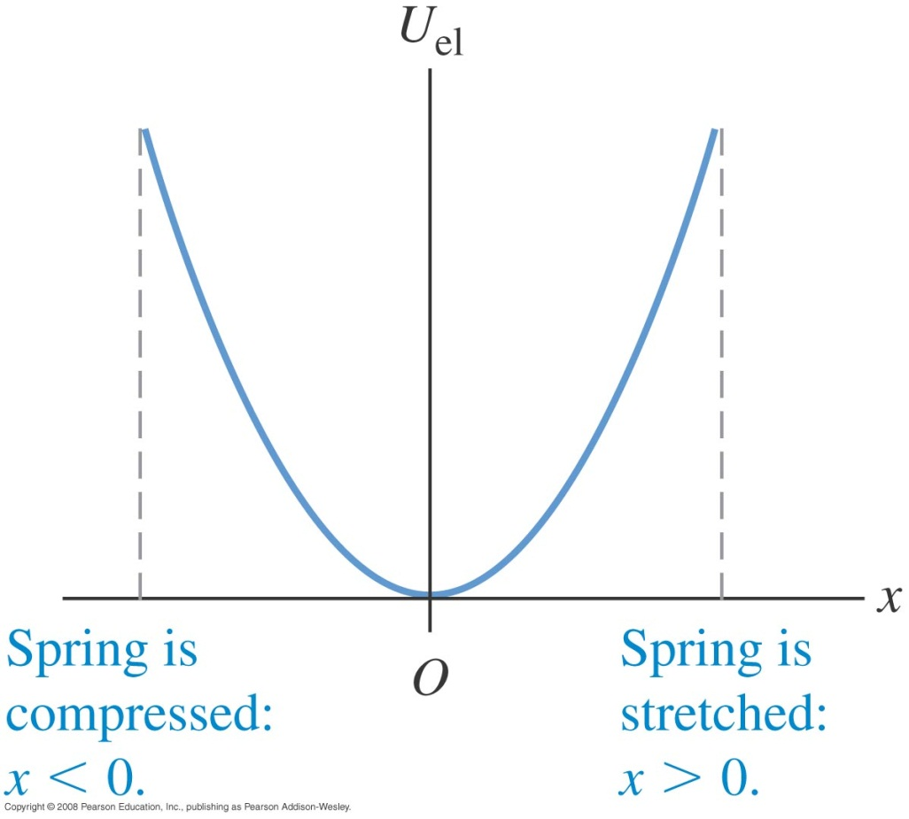
Elastic potential energy
Figure at the right shows a graph of the elastic potential energy for an ideal spring
$$U_{el}+K=E, is conserved$$
It can explain
1. how a car reacts to ground on its suspension
2. the strength of a bungee jump rope so that there is safe landing

Slide 12
Situations with both gravitational and elastic forces
When a situation involves both gravitational and elastic forces, the total potential energy is the sum of the gravitational potential energy and the elastic potential energy
$$U_{tot}= U_{grav}+U_{el}$$
The work done by all forces other than the gravitational force or
elastic force equals the change in the total mechanical energy E (=U+K) of the system

Slide 13
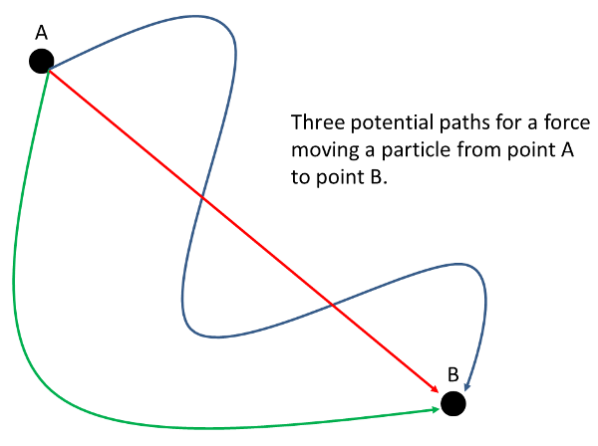
Conservative and non-conservative forces
A conservative force allows conversion between kinetic and potential energy. Gravity and the spring force are conservative
The work done between two points by any conservative force:
a) can be expressed in terms of a potential energy function
b) is reversible
c) is independent of the path between the two points
d) is zero if the starting and ending points are the same
A force (such as friction) that is not conservative is called a non-conservative force, or a dissipative force

Slide 14
Conservation of energy
Nonconservative forces do not store potential energy, but they do change the internal energy of a system.
The law of the conservation of energy means that energy is never created or destroyed; it only changes form.
This law can be expressed as$∆K+∆U+∆U_{int}=0$

Slide 15
Calculation with elastic potential energy
A glider with mass m=0.200 kg sits on a frictionless, horizontal air track, connected to a spring with force constant k= 5.00N/m. You pull on the glider, stretching the spring 0.100m, and release it from rest. The glider moves back toward its equilibrium position (x=0). What is its x-velocity when x = 0.080 m?
As the glider start to move, elastic potential energy is converted
to kinetic energy. Here only spring force does work on the glider,
so Wother =0 and hence conservation of energy sets, E= Uel+ K= constant
$$K_{2}=K_{1}+U_{1}−U_{2}$$
$$v=±0.30 m/s$$

Slide 16
Thank You

